Slide 1
Lecture 15 - Support Vector Machine (SVM)
DS 4400: Machine Learning and Data Mining 1

Slide 2
Today
Today
Classification
SVM
Projections
Simple SVM
In Python
Soft-Margin SVM

Slide 3
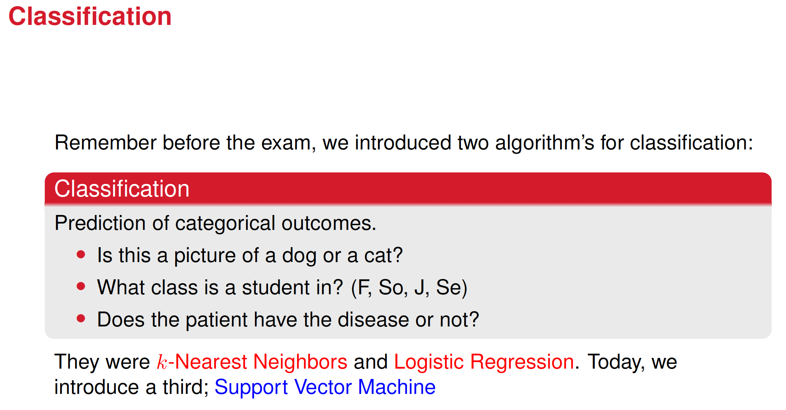

Slide 4
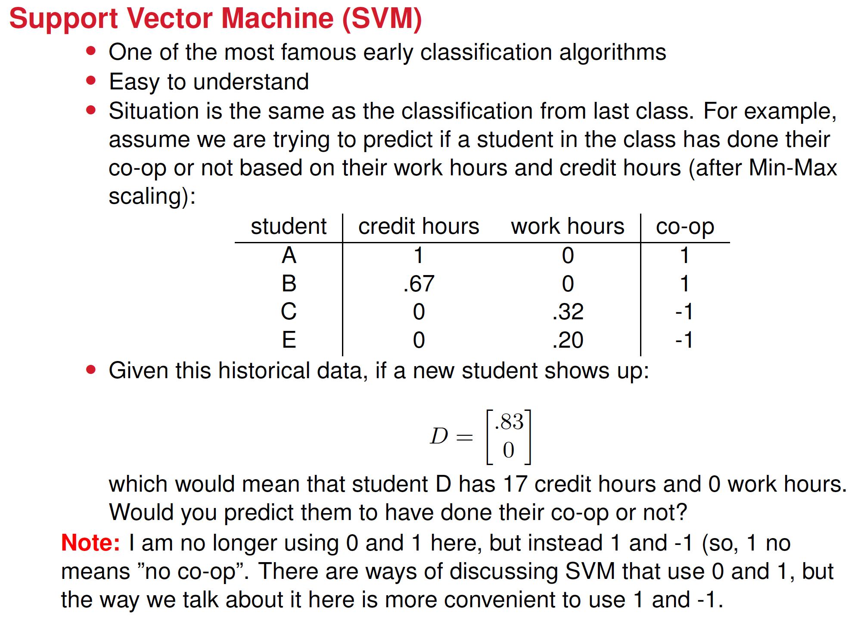

Slide 5
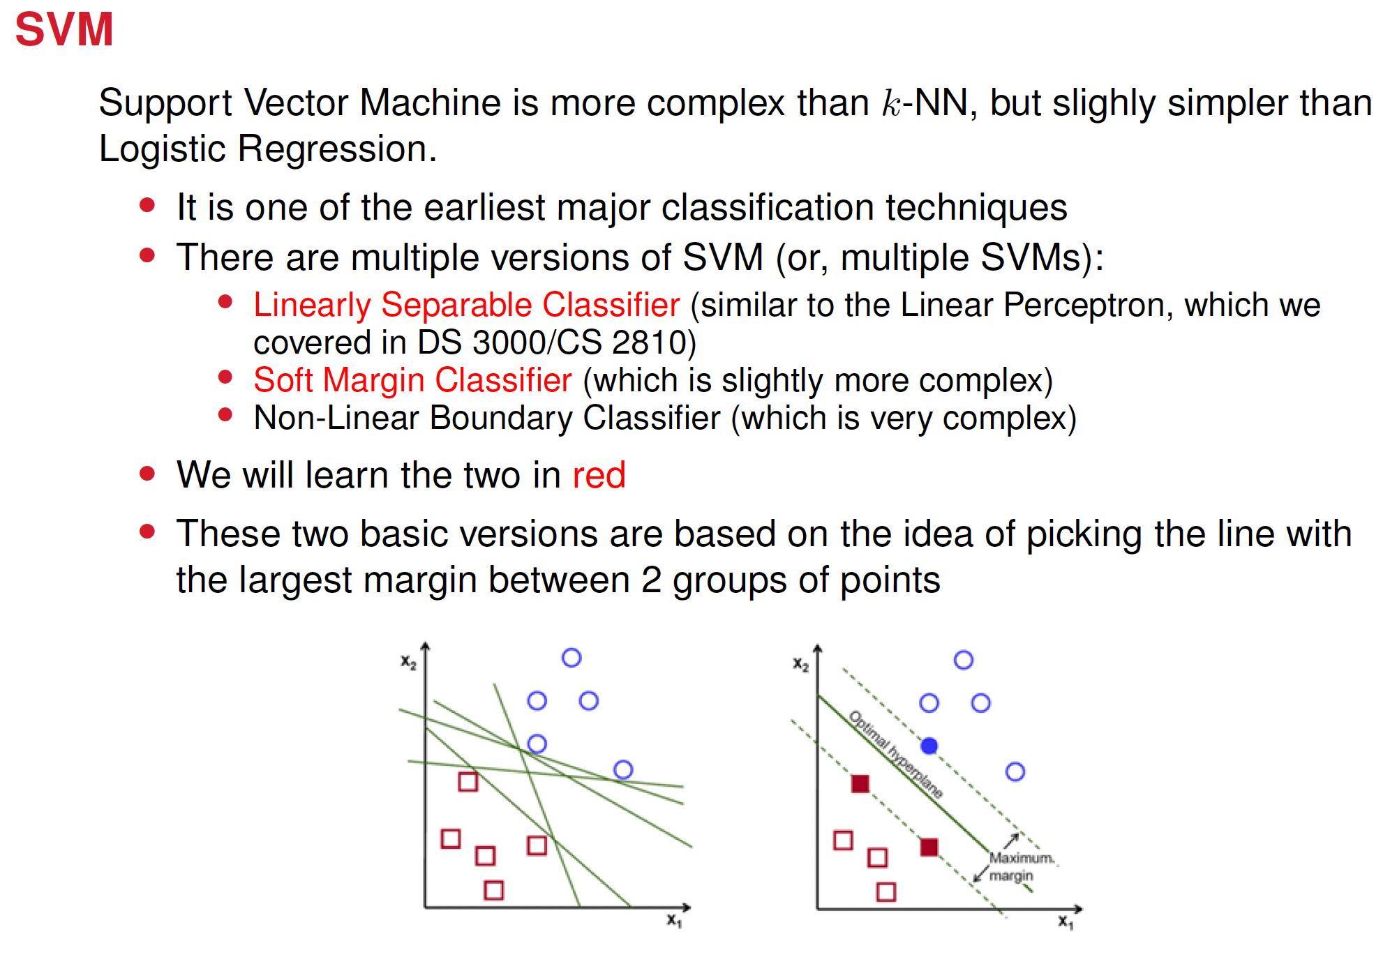

Slide 6
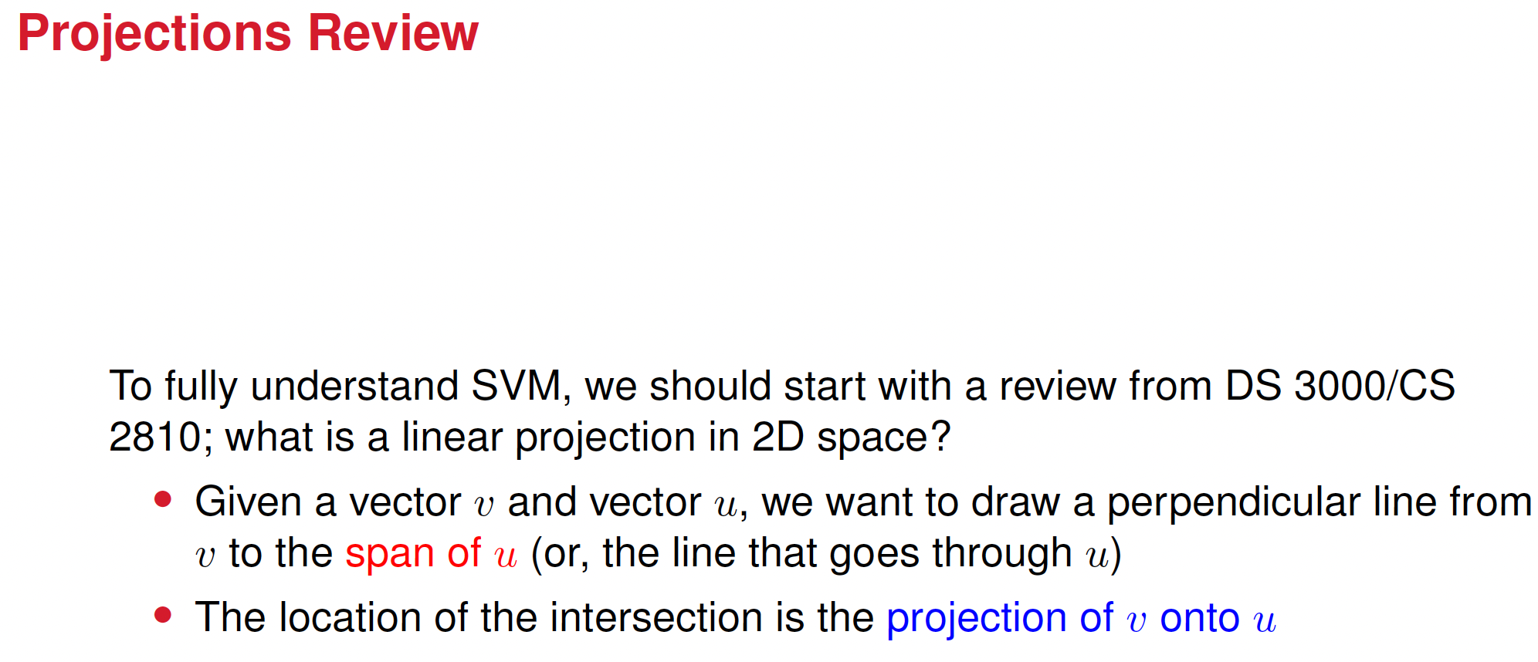




Slide 7
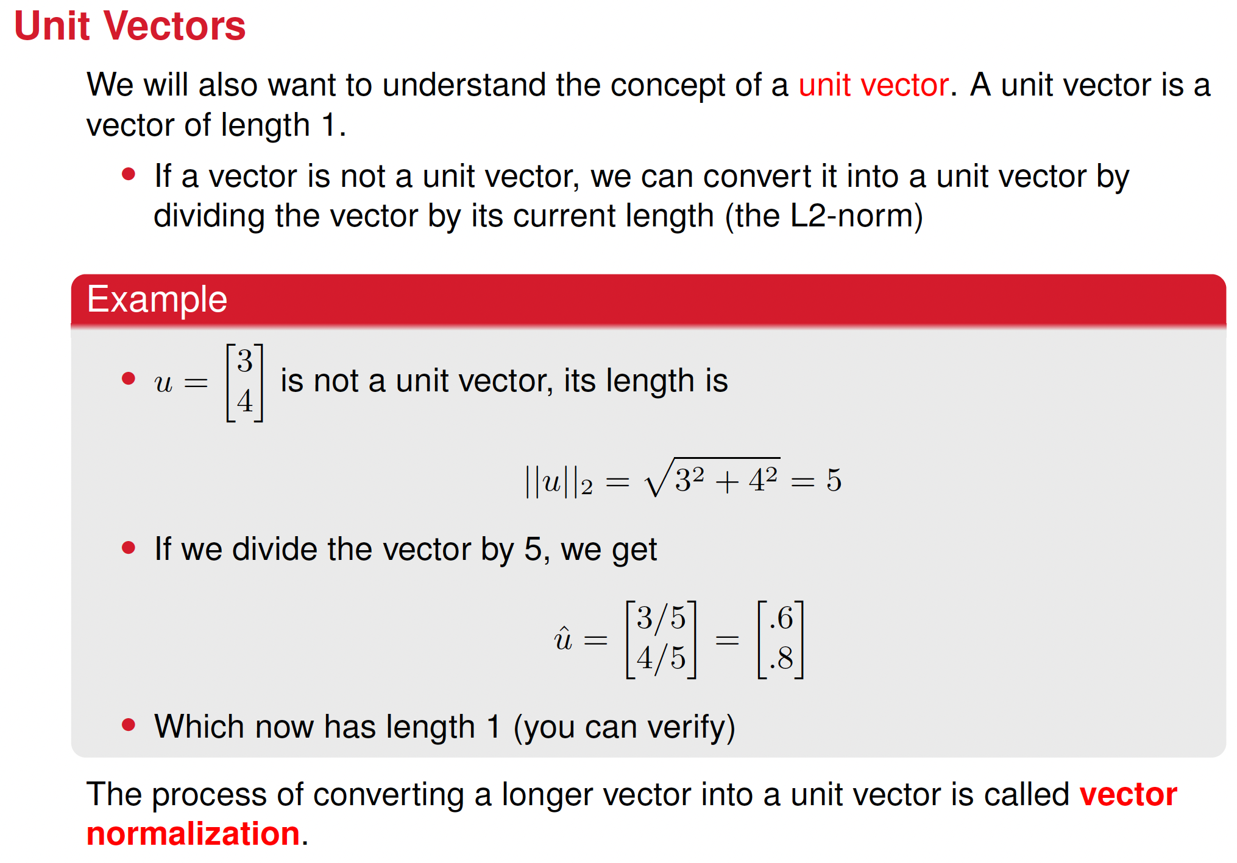

Slide 8
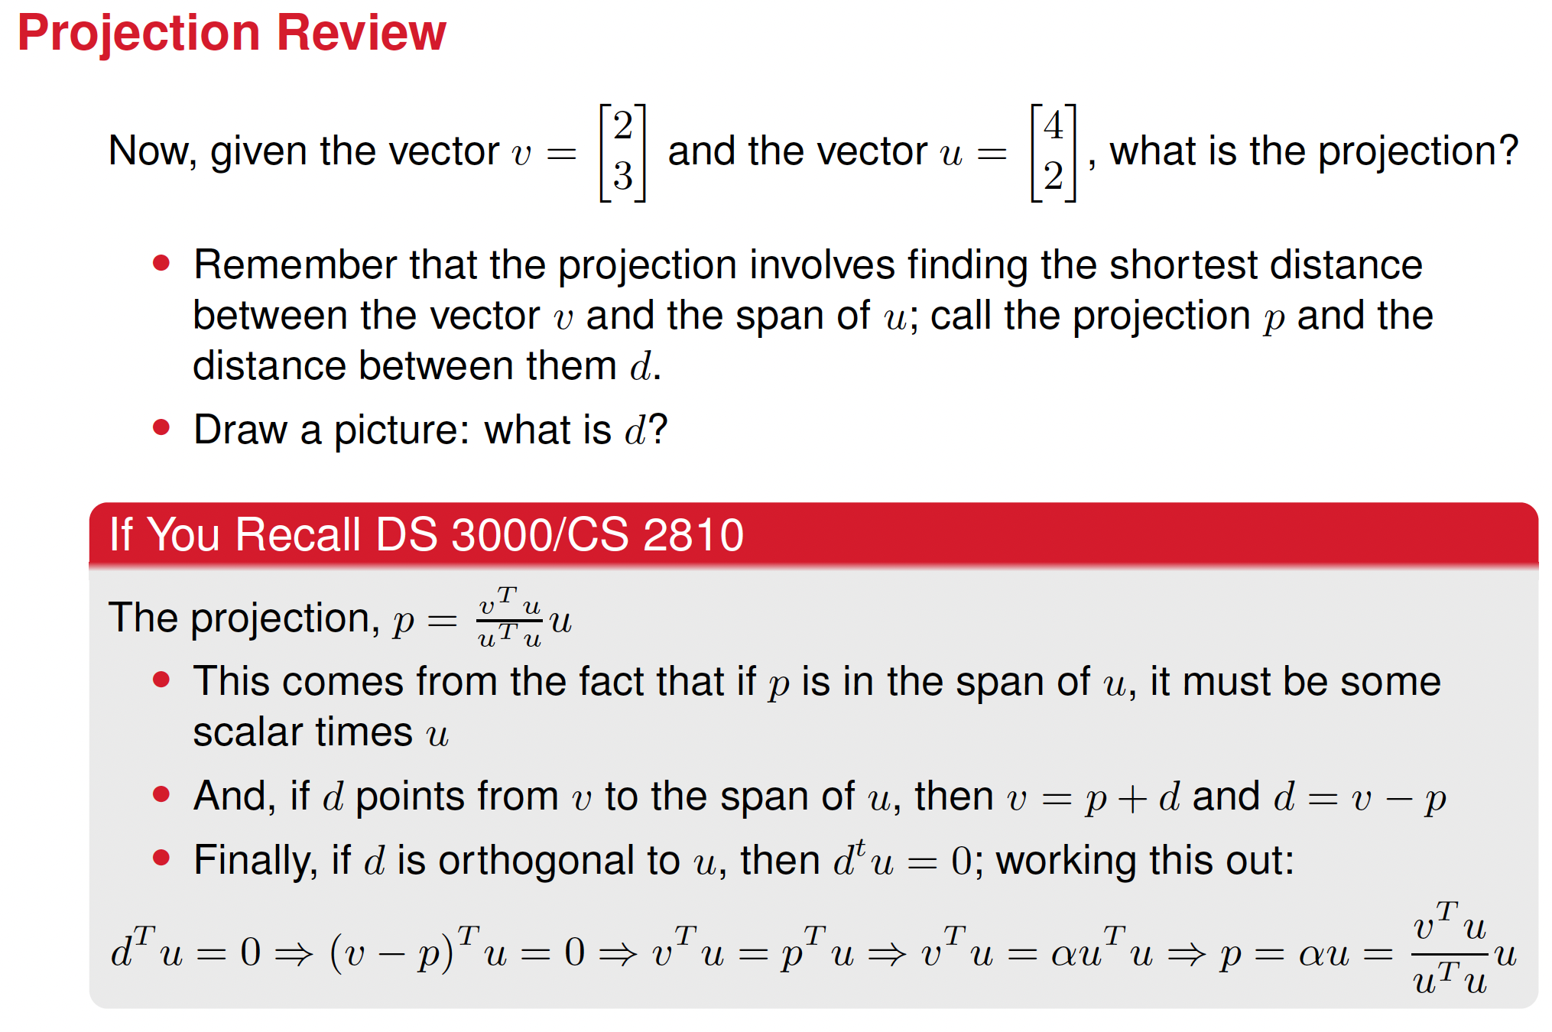

Slide 9























Slide 10
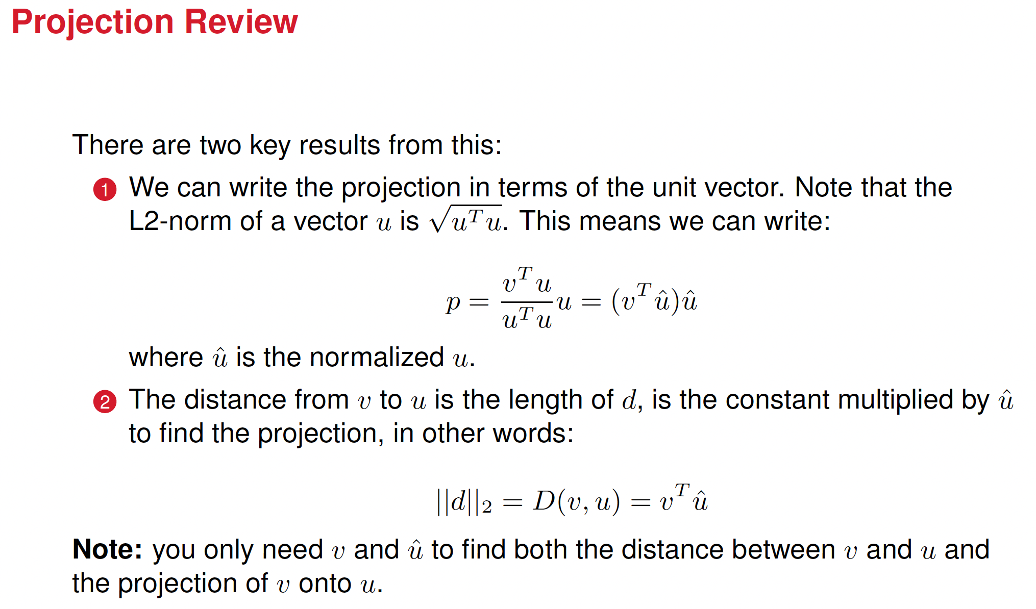
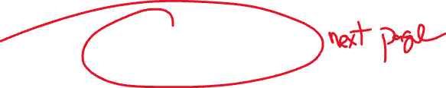

Slide 11








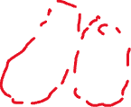













Slide 12
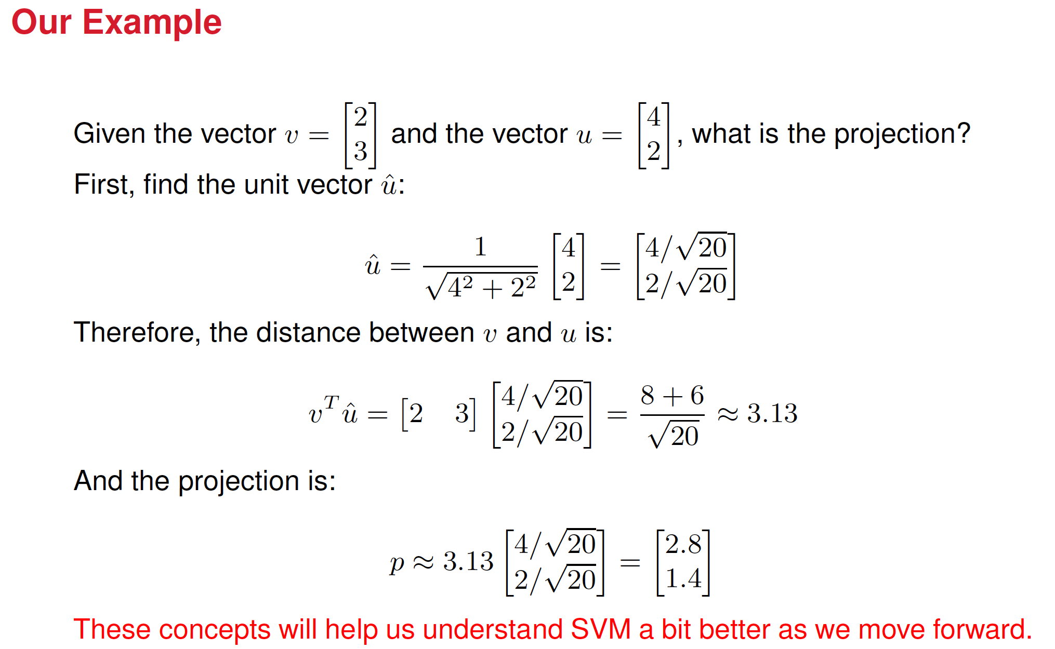
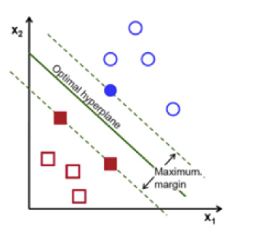

Slide 13
Support Vector Machine (SVM)
A Support Vector Machine (SVM) is a supervised learning algorithm used for classification. The key idea behind SVM is to find the optimal hyperplane that best separates data points into different classes.
How it works:
Finds a hyperplane that separates the data points of different classes.
Maximizes the margin, which is the distance between the hyperplane and the closest points (called support vectors) from either class.

Slide 14
About the margin
A larger margin means the model is more confident in its classification.
If the margin is large, small perturbations in the data are less likely to change the classification outcome.
A large margin improves the generalization ability of the model, which means the model will work better on unseen data.
If the margin is small, the decision boundary is close to the training points so even small variations could push points to the wrong side of the boundary. The model then would have poor generalization.

Slide 15
What are we going to learn today
We are going to learn how the SVM finds the optimal hyperplane
And how it maximizes the margin

Slide 16
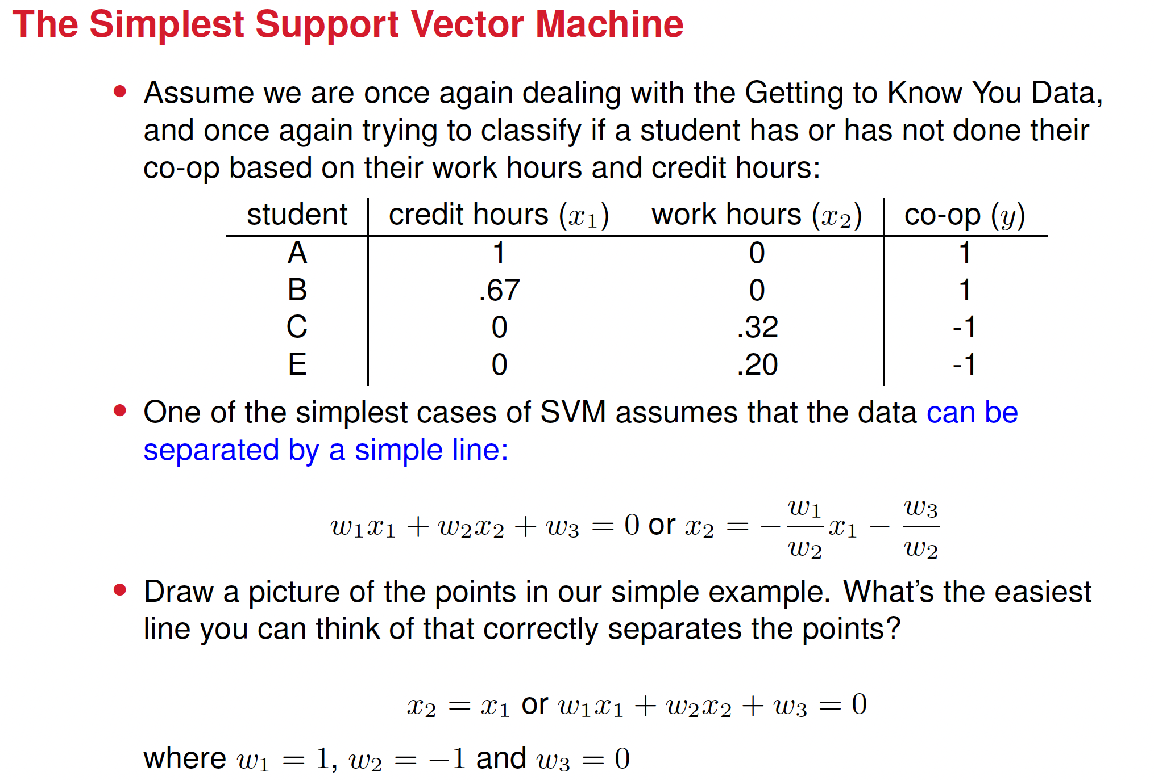
Notes:
Add a graphical explanation of a line for w3 equal and different to 0

Slide 17
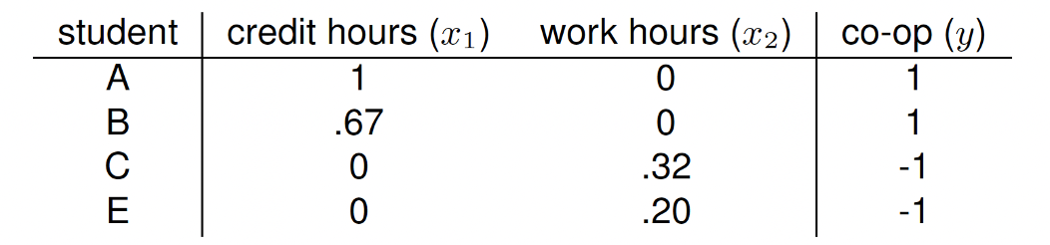
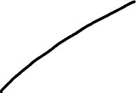






Slide 18















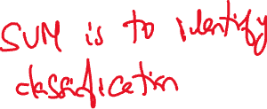








Slide 19











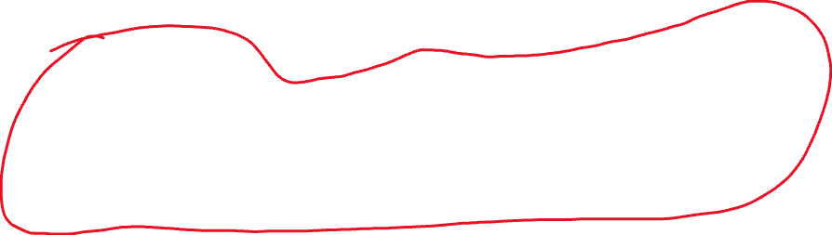






:

Slide 20













Slide 21









The question now is, how to do we find the best line?
We can do this by maximizing correctness.
What is correctness?

Slide 22

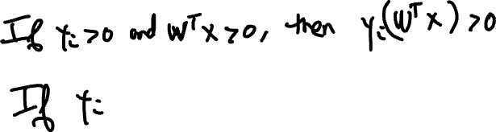



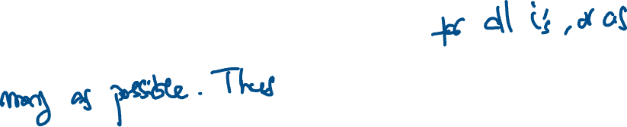
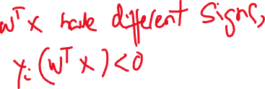




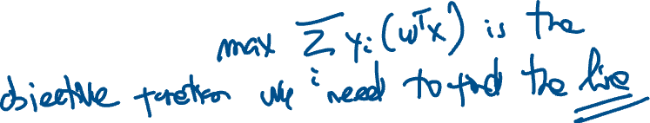


Slide 23
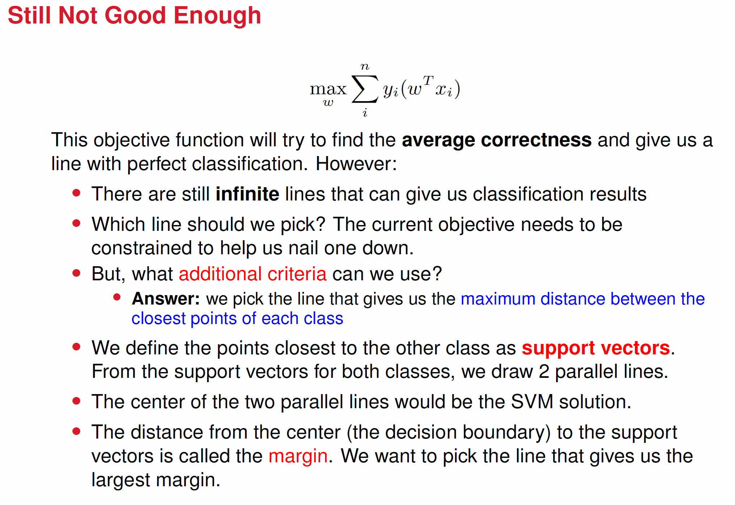
Notes:
Explain better what on earth support vectors mean here

Slide 24
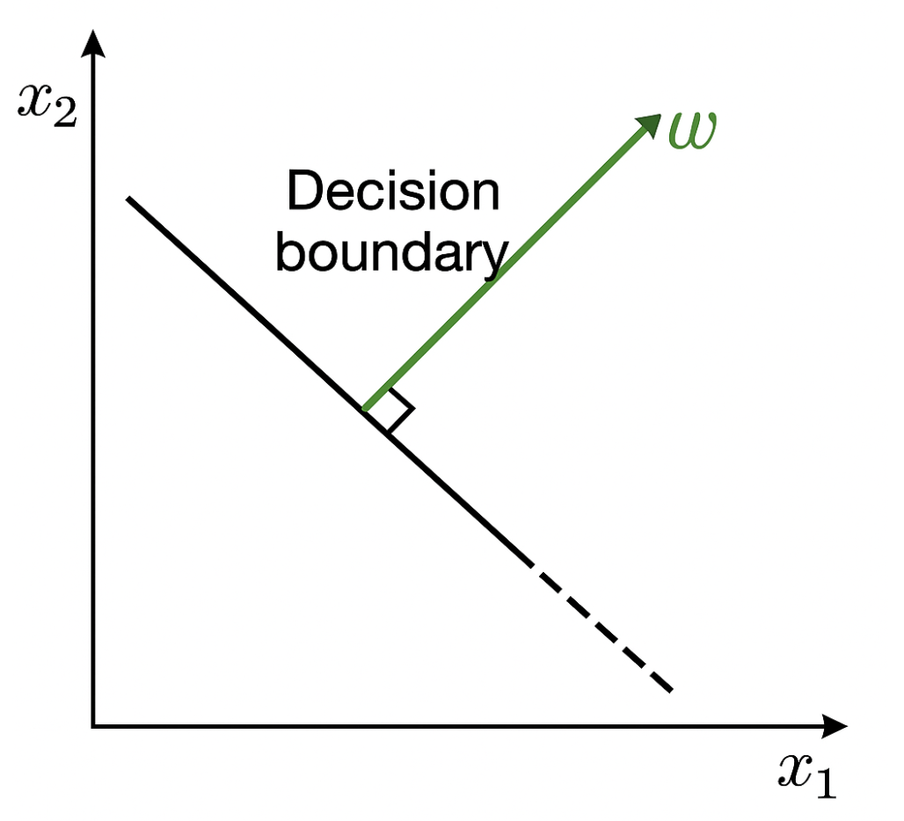
















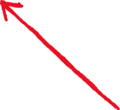



Notice that the decision boundary is perpendicular to W

Slide 25
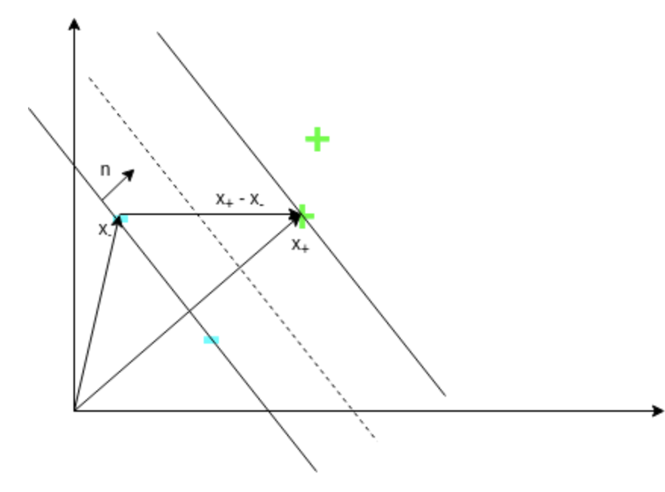
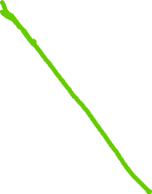





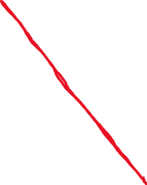

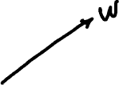








Slide 26






























Slide 27
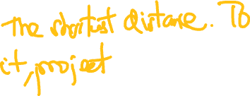














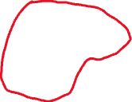







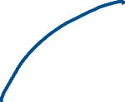


Slide 28









In summary, we need to maximize the distance between
those two planes
Maximizing
Because a larger margin 2/||w|| means a smaller ||w||
Therefore, instead of maximizing the reciprocal, we can minimize the denominator directly.
Thus, the problem becomes:

Slide 29















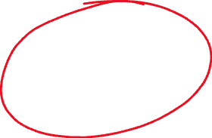
Some tricks used during the minimization

Slide 30
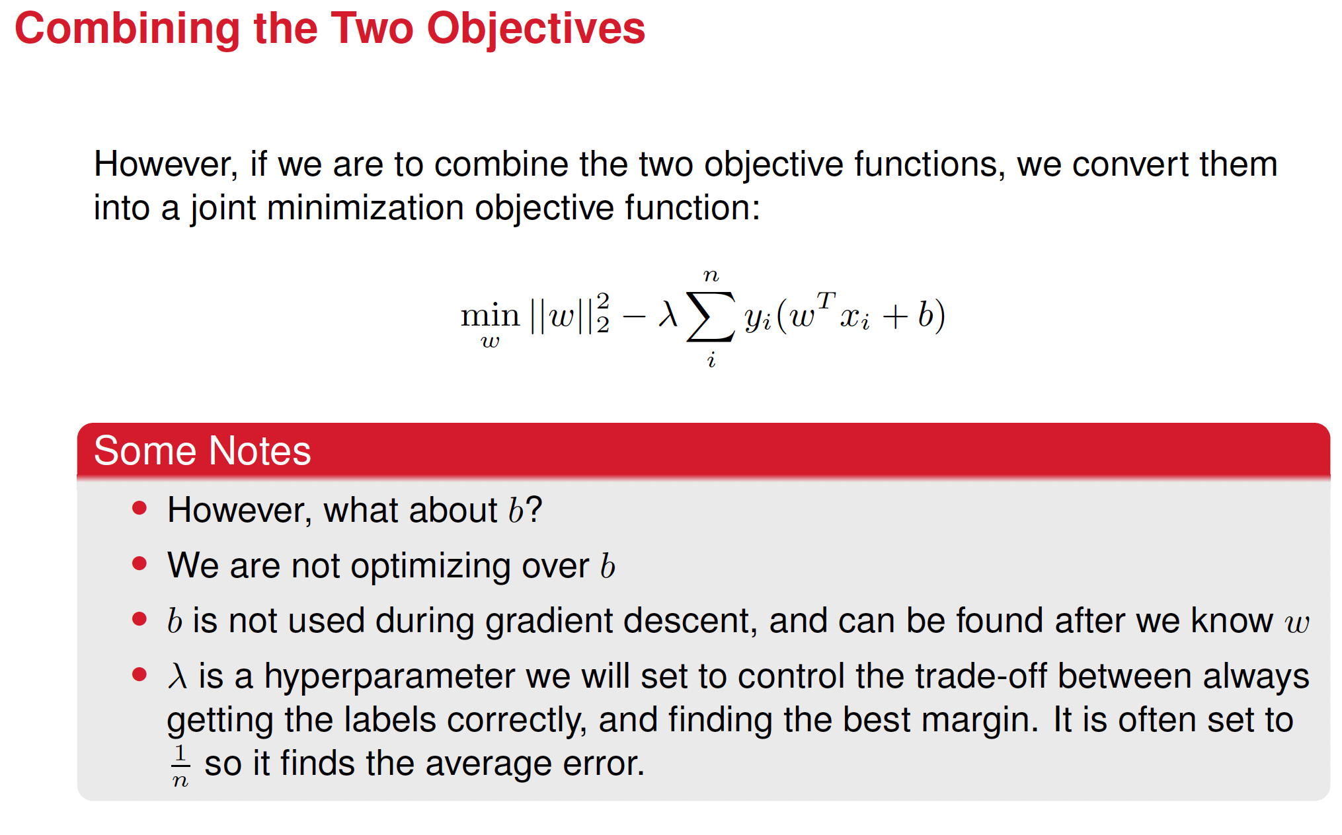










Slide 31
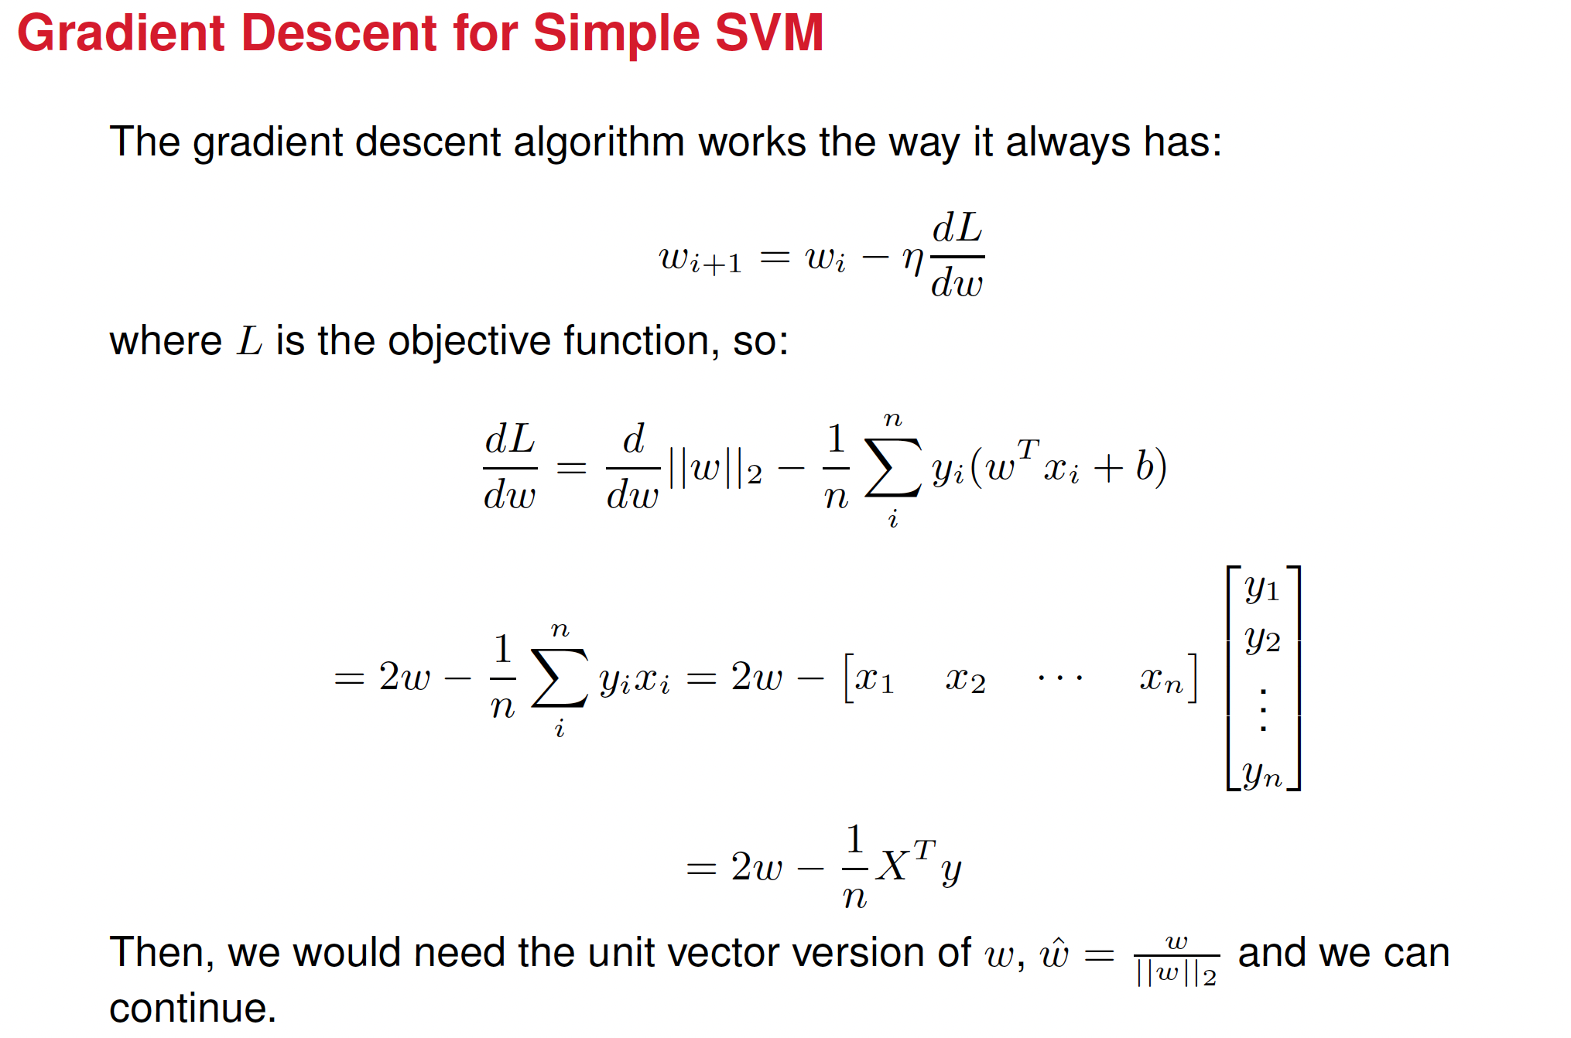

Slide 32
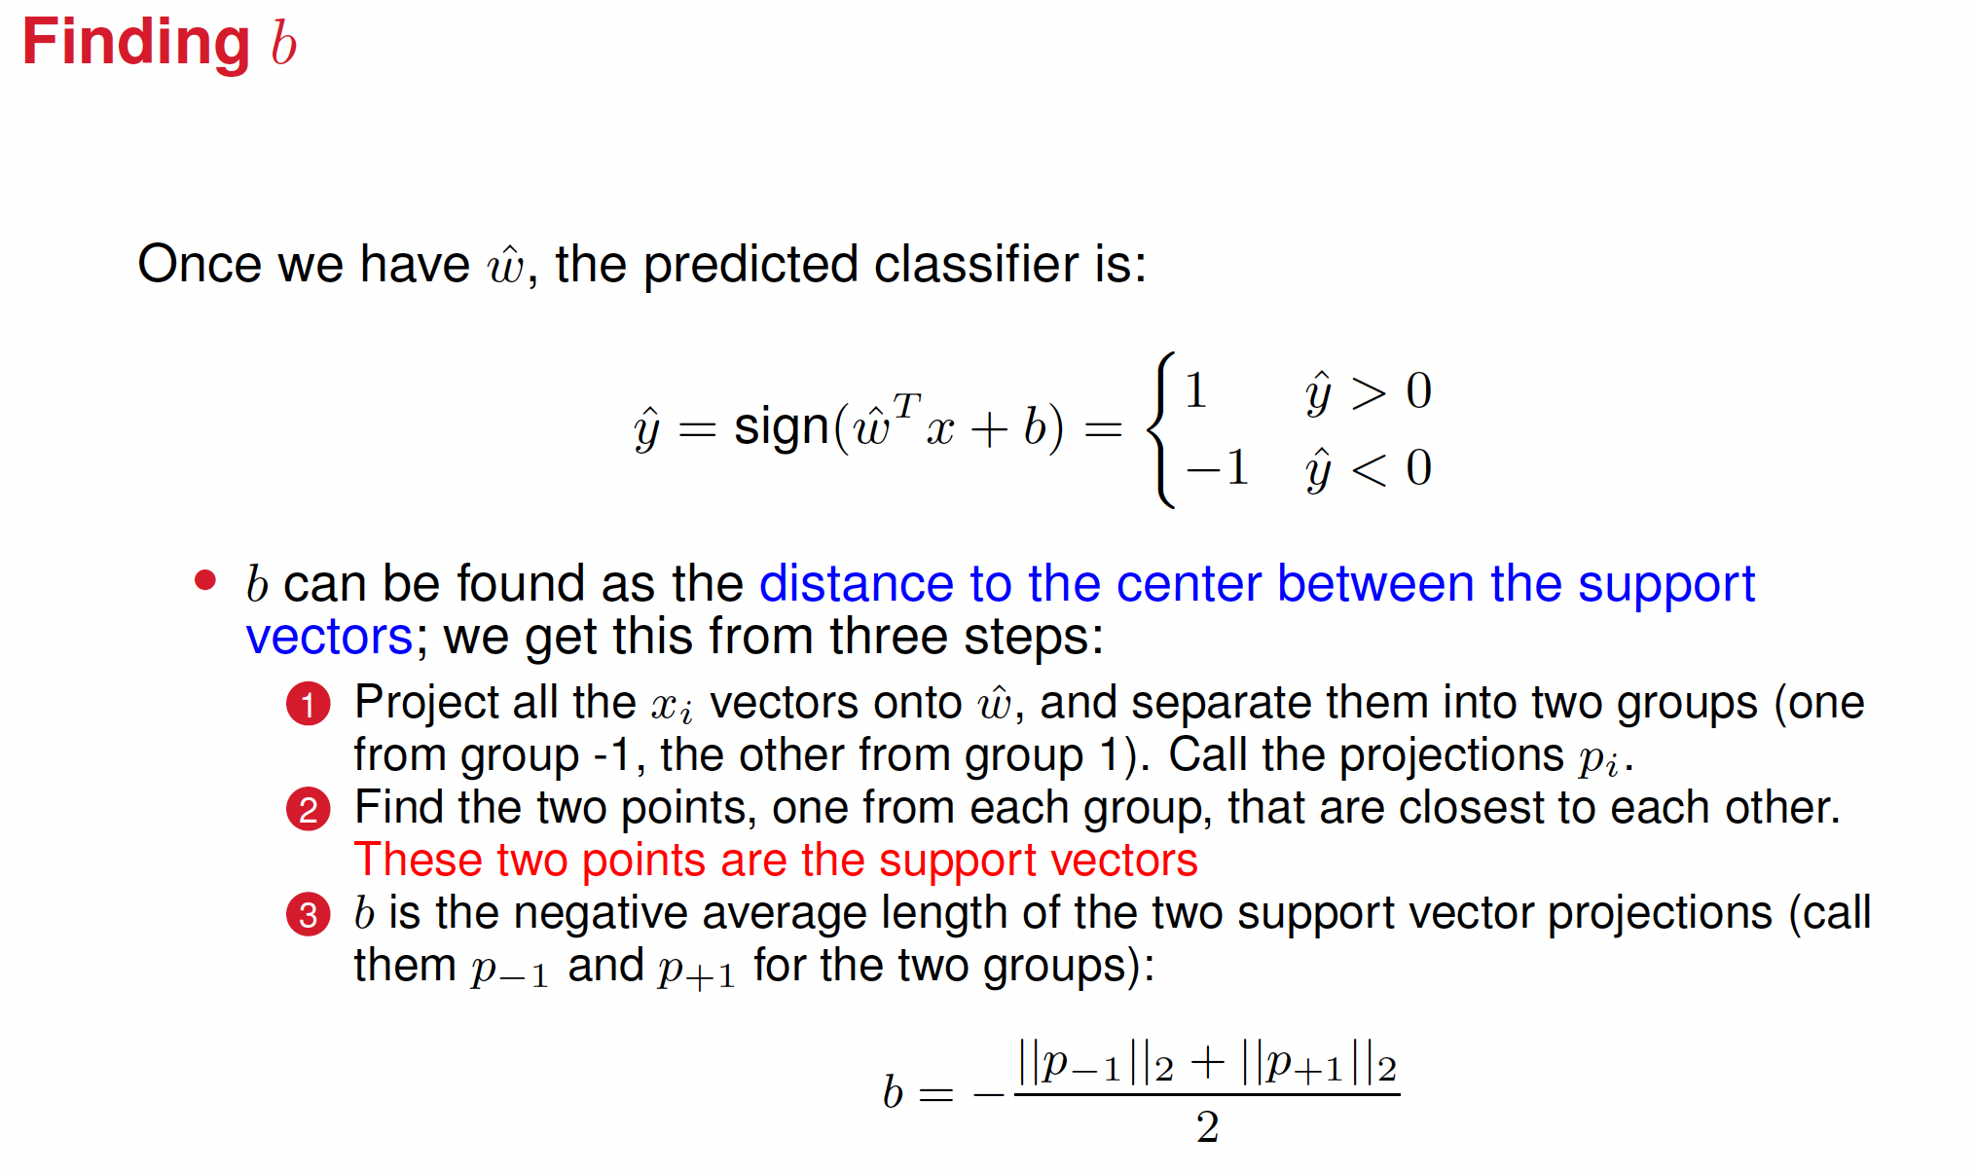






Slide 33
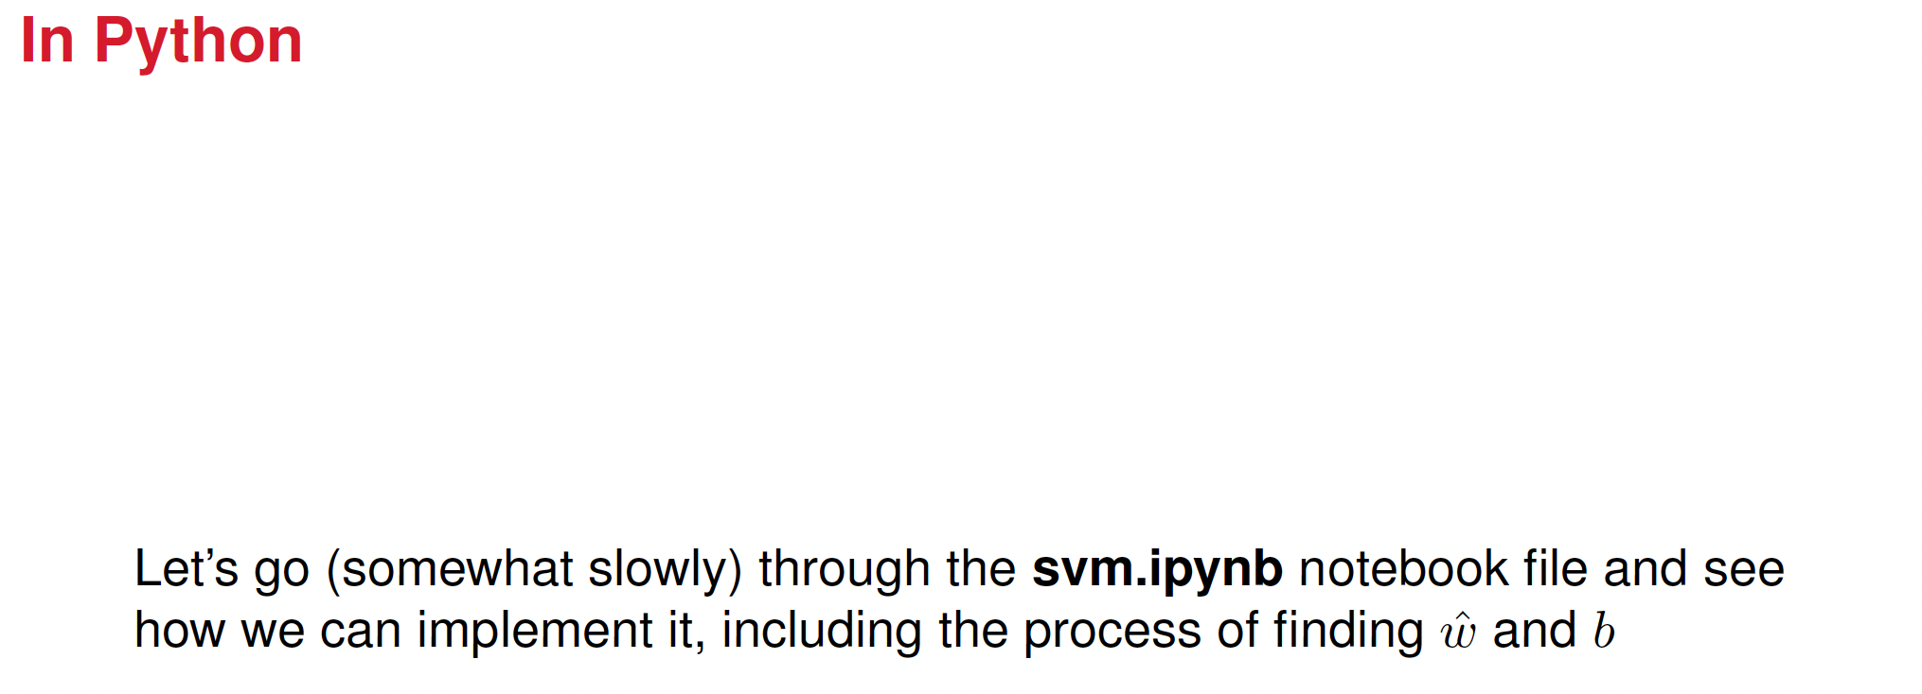

Slide 34
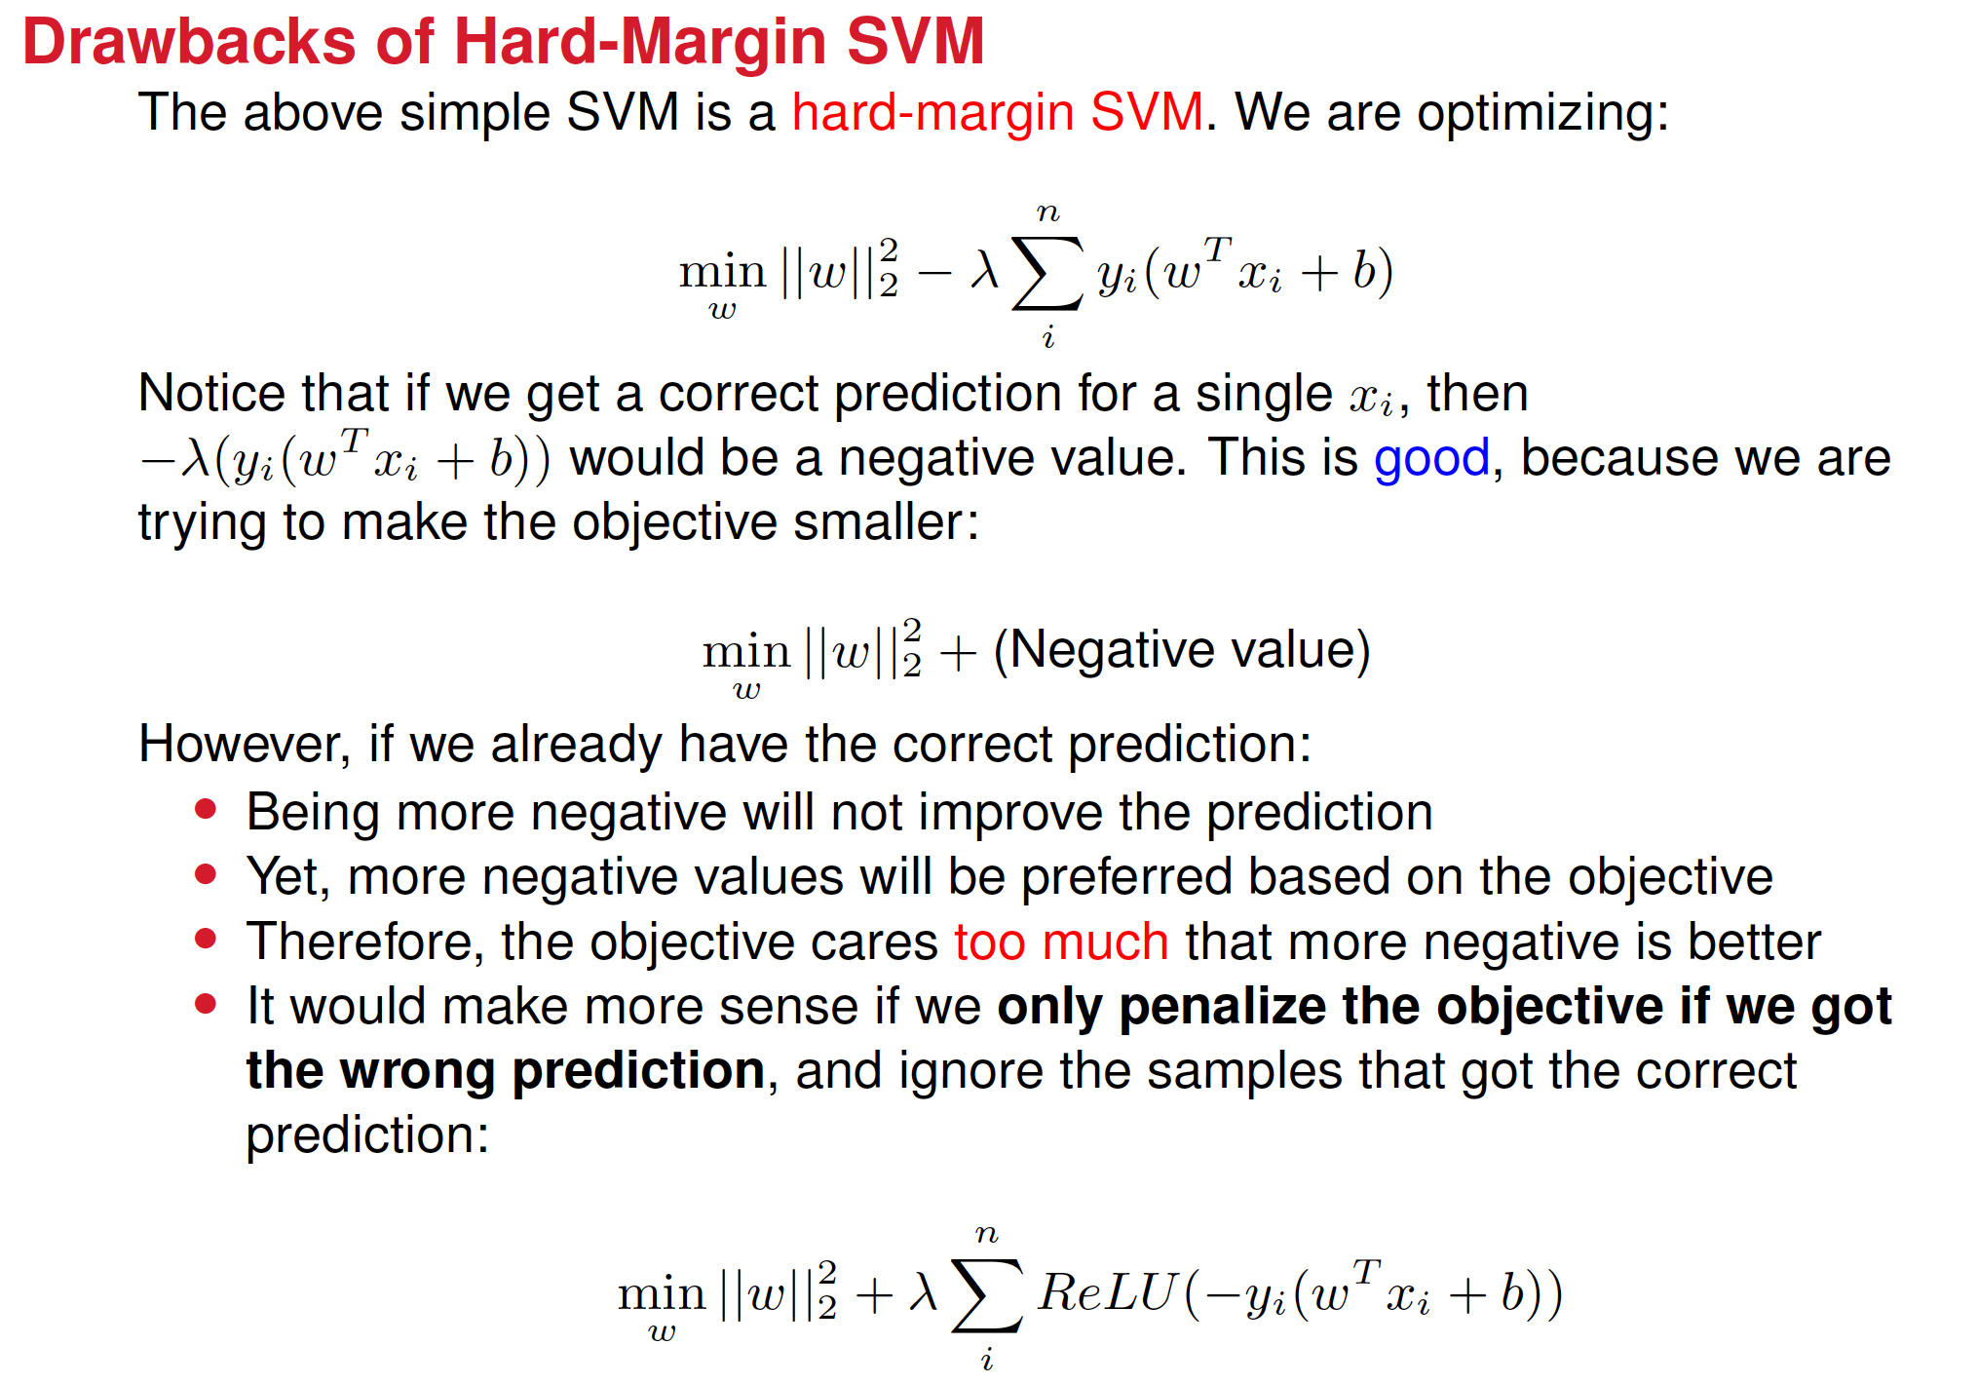

Slide 35
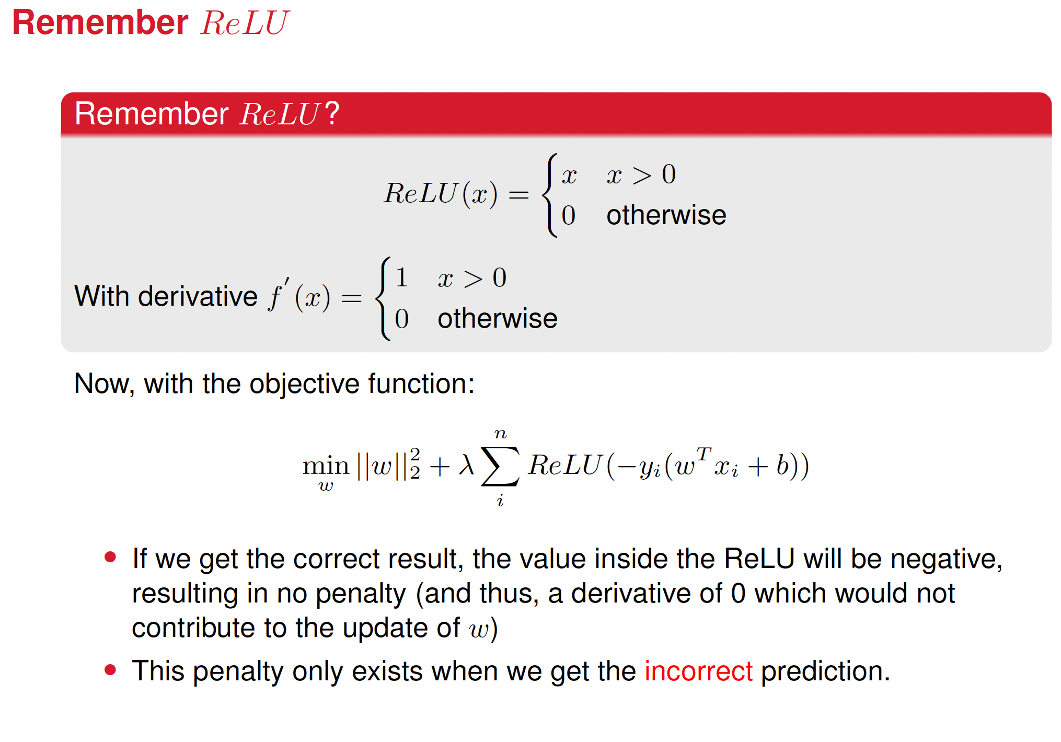

Slide 36
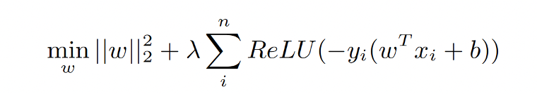
























Slide 37
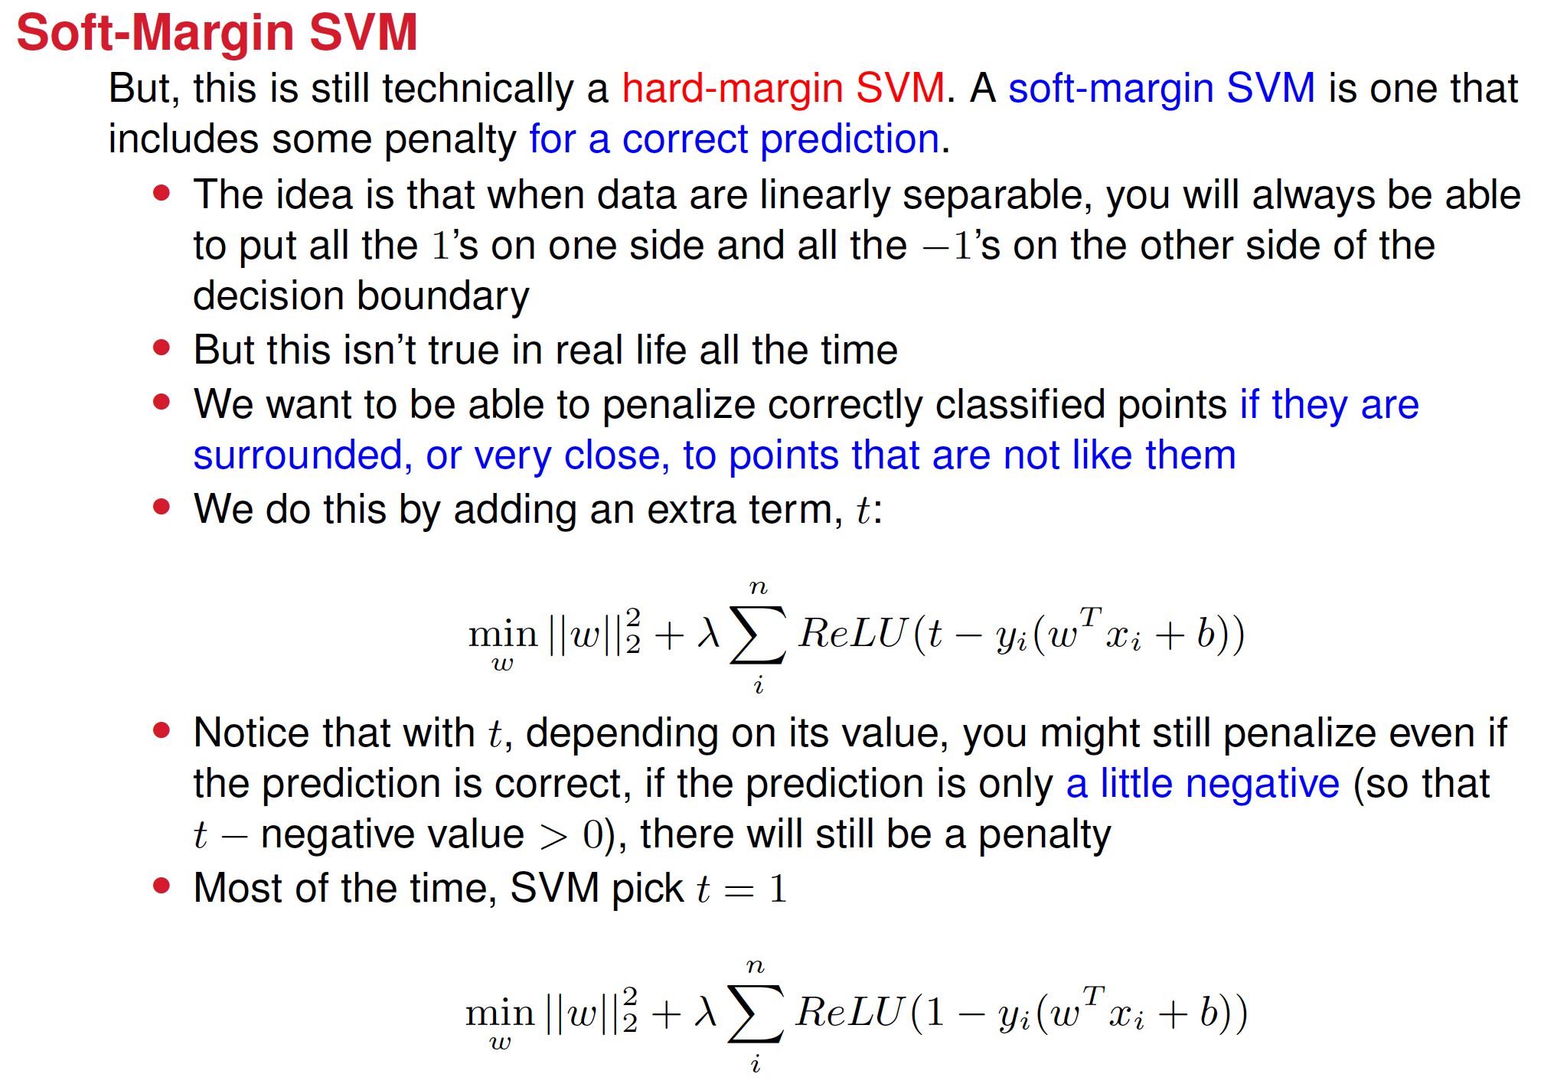

Slide 38
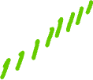

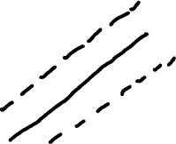
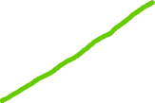

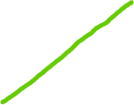
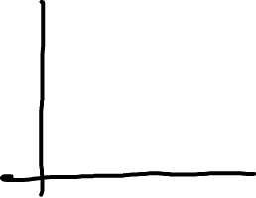
Soft-margin SVM introduces a buffer
A soft margin SVM introduces a buffer such that
If a point is inside the buffer, the classifier does not treat it as confidently classified.
The classifier doesn't want to commit to a classification unless the point is at least 1 unit away from the margin.
If a point is inside the buffer zone, the loss is non-zero , which signals that the classifier still considers it "too close to the boundary" to confidently decide.

